Slide 1
Object Oriented Programming using Java- Day 1
Intermediate Level
Notes:
Welcome to this course on Object Oriented Programming using Java . This course acquaints you with the object oriented concepts, where it is used and compare the structured and object oriented approaches to programming .

Slide 2
Why this course? (Course Objectives)
Object oriented programming is used to build complex and large software systems
Inculcates Object Oriented thought process
Acquaints you with OOP features
This course builds basic vocabulary of OOP
Implementation of OOP features using Java
Object Oriented programming skills are essential for creation of robust software using languages like Java and C#

Slide 3

Topics covered
Introduction to OOP
Object Oriented Concepts
Structured vs OOP
Java as an OOP Language
Java Architecture, Program Structure
Java Identifiers and Operators
Day 1
Type Conversion and Casting
Selection Statements
Iteration Statements
Classes and Objects
‘this’ keyword
Day 2

Slide 4
Topics covered
'static' keyword
Visibility Controls: public and private
Arrays and Strings
Method Overloading
Day 3
Inheritance
Visibility Control: protected
'final' and 'super' keywords
Method Overriding
Abstract Class
Day 4
Interfaces
Packages
Visibility Controls: default
Overview of OOAD and UML
Day 5

Slide 5
References
Grady Booch “Object-Oriented Analysis & Design With Applications”(2nd Edition) in 2007
Craig Larman,“Applying UML and Patterns”, Pearson Education
Herbert Schildt “The complete reference Java 2”, 7th edition, TML publication 2006
Cay S .Horstmann and Gary Cornell “Core Java ^{(TM)} 2”, Volume I--Fundamentals (8th Edition) by Prentice Hall in 2007
Steven Holzner “Java 2 Programming “(JDK 5 Edition) Black Book in 2006 Paraglyph press, Dreamtech press 2006
Web Site : http://java.sun.com/docs/books/tutorial/

Slide 6
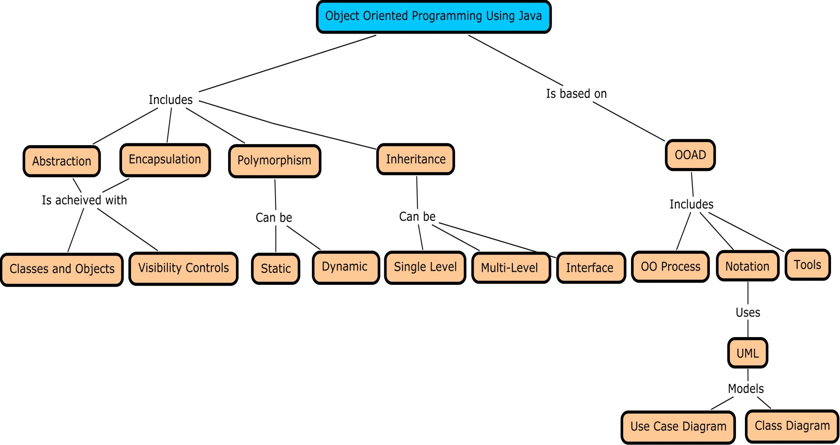
CMap

Slide 7
Session Plan
Introduction to OOP
Object Oriented Concepts
Structured vs OOP
Java as an OOP Language
Java Architecture, Program Structure
Java Identifiers and Operators

Slide 8
Real World Complex systems
A rocket propulsion system – Complex indeed !!
The structure of plants - Complex
Human Brain – A very complex system
The earth and the solar system – highly complex
What about Software??
In real-world, systems are very complex in nature
Comprehending the complexity of such systems are beyond the intellectual capacity of humans

Slide 9
An enterprise application – A complex software system
Pricing
System
Trading
System
Trading Interface
Travel
System
Salary
System
Middleware
HR
System
Policies
System
Remittance
Processing
Demand
Forecasting
My module ???
Departments
& Locations
Web based
Users
Middleware
Business
Intelligence
System
Electronic Fund Transfer
Sales
Analysis
Customer
Support
System
Middleware
Order
Payments
Financial
System
Accounting
System
Finance
Analysis
Ageing
Analysis
Sub-system 1
Funds
Sub-system 2
Brokers
Order
Processing
Customer
Complaints
Assets
Banks
Sub-system 3
Software Systems are also inherently complex
Notes:
The picture shows an enterprise application consisting of various modules, communicating with each other through interfaces

Slide 10
Complex software system- Challenges(1/3)
Users depend upon complex software systems for day to day functioning
Ex: A air-traffic control system, online banking system, a geo-satellite system
It is extremely difficult for a developer to master the whole system and develop the same
It is difficult to understand all the problem domains
The development process of complex systems and managing them becomes very difficult
High level of flexibility is needed in software systems
Eg. POS machines in a retail store
(POS- Point of sale machines)
Notes:
Complex software systems are the order of the day.
In a retail store , POS machines capture the item details, match the code, retrieve the price and then facilitate the bill. But the interface is extremely easy

Slide 11
Complex software system- Challenges(2/3)
Huge software systems need to be developed with the team distributed across locations
The software engineer need to give an illusion of simplicity to the user
It is impossible to test all paths of control in the entire software system and some external events may corrupt the entire system
Eg. If there is a division by zero, and the developer has not tested the possibility, it will hang the whole system
If this complexity is not addressed it may lead to Software Crisis
Notes:
The team of developers may be spread across locations, the application may contain thousands of modules , it becomes difficult to maintain unity amongst diversity and also have integrity in the design of the system
Software crisis is said to exist when there is -
Over-budget
Rework
Project not meeting deadlines
Requirements of customer not met
More on software crisis would be dealt with in the SDM course

Slide 12
Complex software system- Challenges(3/3)
The internal system is composed on many small chip components -Complex
How do we design such complex systems with such simple and flexible interfaces???
The external interface of the computer – Very simple

Slide 13
Handling complex software systems
“The technique of mastering complexity has been known since ancient times :divide et impera(divide and rule)”
-Dijkstra
The solution is to divide the system into smaller components
There are three possible approaches –
Algorithmic or Top Down Approach
Data-Driven Approach
Object Oriented Approach
Notes:
Edsger Djikstra is a Dutch scientist who had conceived the Djikstra’s Algorithms for graphs
In algorithmic design approach , modules are divided into sub-modules till a basic unit is reached . This is the approach learnt in Structured Programming Course
In the Data-Driven Approach, a set of inputs is mapped to a set of outputs. This is useful in information based systems like database systems
In the Object Oriented design approach , the focus is on the objects that compose the problem domain , their behaviour and communication between the objects

Slide 14
Attributes of complex systems(1/3)
Have hierarchy
Exhibit common patterns
Composed of components wherein-
Strong bonding within the component
Loose bonding between the components
Leads to clear separation of functionlity
Complex systems are derived from simpler subsystems
The Object Oriented approach addresses each of these features of complex systems and hence most suitable for developing extremely complex software systems

Slide 15
Attributes of complex systems(2/3)
Clear Separation of Functionality
Plant
Performs Photosynthesis
Leaves
Stem
Leaf
. . .
Root
Holds Branches and Leaves
. . .
Stem
Root Hair
Root Apex
Root Cap
Absorbs Water and Nutrients
. . .
. . .
. . .
Roots
Complex systems show hierarchy
Strong bonding within the component and loose bonding between the components

Slide 16
Attributes of complex systems(3/3)
made up of “cells”
Plant
made up of “cells”
Stem
Leaf
. . .
Root
. . .
Complex systems are exhibit common patterns
Root Hair
Root Apex
Root Cap
made up of “cells”
. . .
. . .
. . .
made up of “cells”
made up of “cells”
Plant
Tree
Seed
Seedling
Complex systems are built from simpler subsystems

Slide 17
Benefits of Object Orientation
Leads to development of smaller but stable subsystems
Such subsystems are resilient to change
Reduces the risk factor in building large systems as they are built incrementally from subsystems which are stable
Hence Object Orientation is suitable for developing extremely complex systems

Slide 18
Structured Programming vs. Object Orientation(1/2)
Structured Programming | Object Oriented Programming
Emphasis on ordering of events ie. Focus is on the process | Emphasis on the objects/agents that cause the event.ie. Focus is on the data
Top Down Approach | Bottom up approach
Useful for systems wherein the data and applications are separate | Useful to develop extremely complex systems
Uses Global data which is not very secure when used in large systems | Has mechanisms to secure the data , termed as “Data Hiding”
Usage areas include hardware level programming eg. embedded systems and device drivers | Usage areas include real world complex systems automated through software – eg. Air Traffic system, Computer integrated Manufacturing systems
The modules are tightly coupled | The components are loosely coupled between them, but the cohesion is high within the component
Notes:
Coupling :
Coupling refers to the interdependence between software modules
Coupling applies to any relationship between software components
Can be defined as mutual dependence of methods. Low coupling is good for design
What is the problem if the modules are tightly coupled?
If the modules are tightly coupled, it makes the system complex as the module is tough to understand. Also it is hard to change or correct such a module by itself if it is highly interrelated with another module
Cohesion --- Give an example

Slide 19
Structured Programming vs. Object Orientation(2/2)
Retail store Main menu
Item Maintenance Menu
Item Purchase Menu
Add Item
Update Item Price
Item Maintenance Menu
Generate Item Report
Search for Item
Generate Bill
Focus is on “data” on which the “things” are performed
Retail Store
Add,update and generate reports
Generate bill and purchase items
Item Master
Purchase
Master
Search for items
Focus is on “doing things”
Structured Approach
Object Oriented Approach
Notes:
The diagram shows a retail store application development as perceived in Structured and Object Oriented approaches
Structured approaches emphasizes on the activities or the process viz, purchase items, item maintenance etc. Object Oriented approach lays focus on the agents that bring in the events namely the Item, Item Purchase and the Retail Store in itself.

Slide 20
Object Oriented Approach
The object Oriented Approach can be understood by the following :
The Object Oriented Concepts
The Object Oriented Process
The Notation Used for representation
The Tools Used for representation
Notes:
The focus of this course would be predominantly on the foundation concepts, Object Oriented Progrmming and the implementation using Java . However , the other point items would be dealt with at an introductory level

Slide 21
Object Oriented Concepts

Slide 22
Object Oriented concepts- Terminology
Object
Class
Abstraction
Encapsulation
Inheritance
Polymorphism

Slide 23
What is an Object?
An Object is
a tangible and/or visible entity
something that may be apprehended intellectually
something towards which thought or action is directed
something that has crisply defined boundaries
etc …
A Better Definition could be
An Object
has state,
exhibits some well defined behavior,
has a unique identity

Slide 24



What is an Object ?
STATE
Red , leather football
BEHAVIOUR
It rolls
IDENTITY
Red Ball Rolls
It is unique among other kinds of balls
Notes:
The football has a colour-red, made with leather – these are the attributes and the state of the object
The football rolls – This represents the behaviour of the object
The football has a unique identity- it is different from a tennis ball or a volley ball

Slide 25
What is a class?
A class is a set of objects that share
a common structure &
a common behavior
A class contains state and behavior
State (Member Variables)
Variables defined inside the class
Not exposed to external world
Behavior (Member Methods)
Functions defined inside the class
Behavior exhibited by the class to external world
Exposed to external world
An object is an instance of a class

Slide 26
An illustration of the Class concept
VEHICLES
Figure shows that all these objects share common properties and behaviour
Vehicle is the class for all kinds of vehicle objects

Slide 27

Association, Aggregation and Composition Relationships with Examples
Association is a simple structural connection or channel between classes and is a relationship where all objects have their own lifecycle and there is no owner.
In other words, association defines the multiplicity between objects. You may be aware of one-to-one, one-to-many, many-to-one, many-to-many all these words define an association between objects
Example: A Student and a Faculty are having an association.

Slide 28
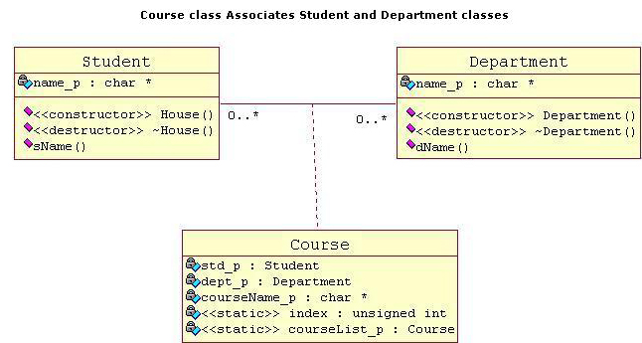
Lets take an example of Department and Student.
Multiple students can associate with a single Department and single student can associate with multiple Departments, but there is no ownership between the objects and both have their own lifecycle. Both c
an create and delete independently.

Slide 29

.
Aggregation is a specialize form of Association where all object have their own lifecycle but there is a ownership like parent and child. Child object can not belong to another parent object at the same time. We can think of it as "has-a" relationship.
Aggregation is also called a “Has-a” relationship.

Slide 30
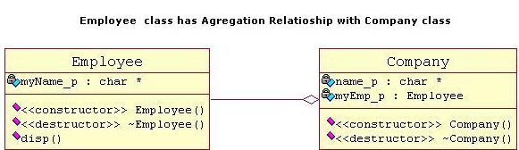
Lets take an example of Employee and Company.
A single Employee can not belong to multiple Companies (legally!! ), but if we delete the Company, Employee object will not destroy.

Slide 31

Composition is again specialize form ofAggregation. It is a strong type of Aggregation. Here the Parent and Child objects have coincident lifetimes. Child object dose not have it's own lifecycle and if parent object gets deleted, then all of it's child objects will also be deleted.

Slide 32
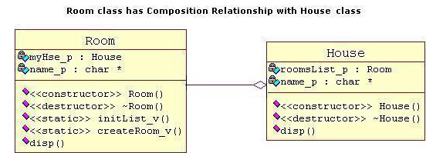
Lets take an example of a relationship between House and it's Rooms.
House can contain multiple rooms there is no independent life for room and any room can not belong to two different house. If we delete the house room will also be automatically deleted.

Slide 33
Difference between aggregation and composition
Composition is more restrictive.
When there is a composition between two objects, the composed object cannot exist without the other object.
This restriction is not there in aggregation.
Though one object can contain the other object, there is no condition that the composed object must exist.
The existence of the composed object is entirely optional.
In both aggregation and composition, direction is must.
The direction specifies, which object contains the other object.

Slide 34
Example: A Library contains students and books. Relationship between library and student is aggregation.
Relationship between library and book is composition.
A student can exist without a library and therefore it is aggregation.
A book cannot exist without a library and therefore its a composition.
For easy understanding I am picking this example. Don’t go deeper into example and justify relationships!

Slide 35

Generalization
Generalization uses a “is-a” relationship from a specialization to the generalization class.
Common structure and behavior are used from the specialization to the generalized class.
At a very broader level you can understand this as inheritance.
Why I take the term inheritance is, you can relate this term very well. Generalization is also called a “Is-a” relationship.
Example: Consider there exists a class named Person. A student is a person. A faculty is a person. Therefore here the relationship between student and person, similarly faculty and person is generalization.

Slide 36

Realization
Realization is a relationship between the blueprint class and the object containing its respective implementation level details. This object is said to realize the blueprint class. In other words, you can understand this as the relationship between the interface and the implementing class.
Example: A particular model of a car ‘GTB Fiorano’ that implements the blueprint of a car realizes the abstraction.

Slide 37

Dependency
Change in structure or behaviour of a class affects the other related class, then there is a dependency between those two classes. It need not be the same vice-versa. When one class contains the other class it this happens.
Example: Relationship between shape and circle is dependency.

Slide 38
Abstraction(1/2)
Defined as the process of exposing the essential details and hiding the non-essential details
Helps simplify the understanding and using of any complex system
Eg.One does not have to understand how the engine works to drive a car
Eg.Similarly one does not have to understand the internal implementation of a software object to use it
Notes:
The process of exposing the relevant details and hiding the irrelevant details is called Abstraction. Abstraction is not an entirely new concept introduced by OOP. Structured Programming also supported abstraction with the help of data structures and functions. For example, one need not know the internal details of the printf function of C to use it. One need not know about how characters are converted to ASCII code and stored in the memory for using a character array.
OOP provides better abstraction. While structured programming provides abstraction at the level of data structures and function, OOP provides abstraction at a higher level; that is at the level of objects. Higher the abstraction level easier it is to understand.

Slide 39
Abstraction
Abstraction(2/2)
Abstraction hides the essential and non-essential characteristics based on the perspective of the user
Chloroplast, Pigments,
Cells …
Petals, Stigma, Stylus …
Micro Biologist
Botanist
A ROSE, as fair as ever saw the North, Grew in a little garden all alone ;A sweeter flower did Nature ne'er put forth , Nor fairer garden yet was never known
Poet

Slide 40
Encapsulation(1/3)
Encapsulate = “En” + “Capsulate”; En = “In a”; Encapsulate = “In a Capsule”
Localization of information of knowledge within an object
Information hiding
Eg. The dashboard of a vehicle encapsulates all the internal parts and hides certain details as well
Notes:
Encapsulation is the process of binding the data and the related functions together in a module and preventing other modules from directly accessing the data . This is clearly better than global data in structured programming which can be access by any module

Slide 41
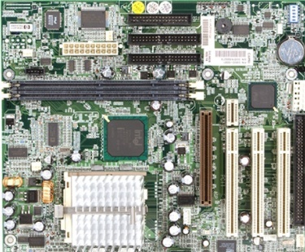
Encapsulation(1/3)
The details of the components are hidden/encapsulated , exposing only the interfaces- the I/O devices and the CPU cabinet
The CPU contains the motherboard whose view is shown. The CPU cabinet encapsulates the details and exposes the essential ones
Notes:
Encapsulation is the process of binding the data and the related functions together in a module and preventing other modules from directly accessing the data . This is clearly better than global data in structured programming which can be access by any module

Slide 42
Inheritance (1/2)
Concept wherein a class shares some common structure or behaviour with one or more classes
Leads to the concept of Reusability of code
Classes are arranged in a tree like structure called a hierarchy
Base class:
The class providing the implementation
Derived class:
The class inheriting the implementation
Notes:
Inheritance is the mechanism which allows a class A to inherit properties of a class B. We say “A inherits from B''. Objects of class A thus have access to attributes and methods of class B without the need to redefine them.
Inheritance also promotes reuse. You don't have to start from scratch when you write a new program. You can simply reuse an existing repertoire of classes that have behaviors similar to what you need in the new program.

Slide 43
Inheritance(2/2)
Base Class
Derived Classes
Vehicle
Land Vehicle
Water Vehicle
Air Vehicle
Rail Vehicle
Road Vehicle

Slide 44
Polymorphism(1/2)
Refers to an object’s ability to behave differently depending on its type
Poly = ‘many’
morph = ‘form’
Practice of using same method name/object to denote several different operations
Notes:
Ability to take different forms is called polymorphism. In structured programming each function should have a unique name. Such languages are called monomorphic

Slide 45
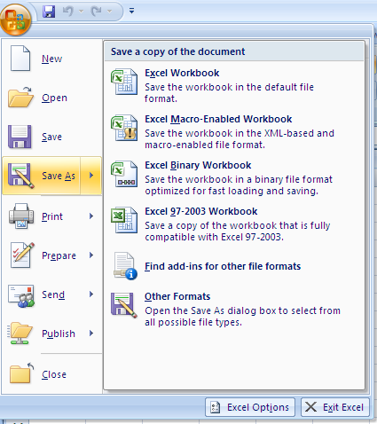
Polymorphism(1/2)
Save As is used in MS-Excel application
Notes:
Ability to take different forms is called polymorphism. In structured programming each function should have a unique name. Such languages are called monomorphic languages. The languages wherein an object/element can have a single name ,but behave differently in different situations are called polymorphic languages .

Slide 46
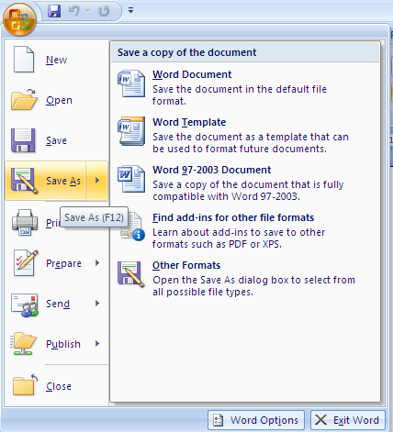
Polymorphism(1/2)
Save As is used in MS-Word Application
Notes:
Ability to take different forms is called polymorphism. In structured programming each function should have a unique name. Such languages are called monomorphic languages. The languages wherein an object/element can have a single name ,but behave differently in different situations are called polymorphic languages .

Slide 47
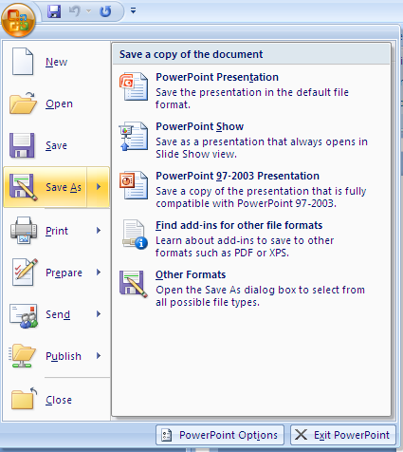
Polymorphism(1/2)
Save As is used in S-Powerpoint Application
The Save As option saves the file differently depending on the application viz. Excel,Word or PowerPoint , but the option remains the same in any Microsoft application
Notes:
Ability to take different forms is called polymorphism. In structured programming each function should have a unique name. Such languages are called monomorphic languages. The languages wherein an object/element can have a single name ,but behave differently in different situations are called polymorphic languages .

Slide 48
Access Specifiers
Used to expose or hide the details/attributes in a class
Public
A declaration that is accessible to all clients
Protected
A declaration that is accessible to only to the class itself and its subclasses
Private
A declaration that is accessible to only to the class itself
Notes:
The details of implementation will be shown in due course using Java. It is dealt in this slide in terms of bringing an awareness to the terms

Slide 49
Class Diagram – Components
Customer
-customerNo:int -customerName:String
+getCustomerNo():int +setCustomerNo(int) +getCustomerName():String +setCustomerName(String) +displayBillAmount()
Name of the class
- Represents private access specifier
Attributes of the class
+ Represents public access specifier
Methods or activities in the class
Notes:
Recollect the concept of Encapsulation and Abstraction learnt earlier as part of the OO concepts. This diagram represents both the features . The Customer class encapsulates/hides the Customer Id and Name(attributes of the class). Hence we say these attributes are private to the class. It exposes the get and set methods which are public . These methods allow limited access to the attributes through them. Registered and Regular customers are a kind of customer, representing inheritance or hierarchy learnt earlier
The details of class diagrams and Object Oriented Process will be dealt with on Day 5 of the course

Slide 50
A Sample Java Program
Let us consider implementing a class using Java
class HelloWorld{
public static void main(String [] args){
System.out.println(“Hello World!”);
}
}
Steps to create and execute a Java program:
The code can be created in an editor
Save the file as HelloWorld.java
Compile the program
Execute the code
Notes:
A Java program file is an ordinary text file with “. java” extension. Java source files may be created in a plain text editor like Notepad.
Any code in Java is to be written inside a class. Just like the C language, the program execution starts with the main method. In C, the function main is a global function. But in Java, even the main method should be inside a class.
The details of the syntax will be dealt in due course of time

Slide 51
The Java Programming Language - History
A language developed by Sun Microsystems
A general-purpose language
High-level language
Developed initially for consumer devices
Popular platform to develop enterprise applications
Finds use in internet based applications
Notes:
Java was conceived by a team of engineers in Sun Microsystems in 1991 as a part of a research project, which was led by James Gosling and Patrick Naughton. It took 18 months to develop the first working version. This language was initially called “Oak” but was renamed as “Java” in 1995.Modeled after C++, the Java language was designed to be small, simple, and portable across platforms and operating systems, both at the source and at the binary level, which means that the same Java program can run on any machine

Slide 52
Goals – Why Java?
Software was increasingly becoming network- centric
Network included a wide range of devices that interconnect with each other
A network may have diverse hardware architectures, operating systems, and purposes
Goals of Java were –
Platform Independence
Writing secure network mobile programs
Features in the language leading to robustness
Notes:
Java addresses the challenge of writing programs that run on networks by enabling the creation of platform-independent programs. Java programs can be easier and cheaper to develop, administer, and maintain.
Another challenge on the network is the security of data. Networks present an opportunity for malicious code to be circulated Java addresses this by providing an environment in which programs downloaded across a network can be run with some degree of security.

Slide 53
Features (1/2)
Object-oriented
Pure Object oriented Language - class definitions are mandatory
Programmer friendly features
Compared to earlier OO languages like C++, it is simpler for the programmer to use the features
Designed considering the pitfalls of earlier languages
Robust
Exception handling is built-in as part of the language
Strong type checking (all data must be declared to belong to an explicit type)
Local variables must be initialized
Notes:
Object Oriented
Object-Oriented design is a technique that helps the programmer visualize the program using real-life objects. Ease of use and Reusability are the other benefits of Object Orientation
Simple
Certain complex features like operator overloading, multiple inheritance, pointers, explicit memory de- allocation by the programmer are not present in Java language
Robust
Two main reasons for program failure are related to: (1) memory management (2) run time errors
Memory management is very easy since the de allocation is done by the garbage collection system automatically (more on this later)
Java provides object oriented exception handling to manage run time errors (covered later in Java stream).
Exception refers to abnormal execution of a program under some circumstances. The code written in Java mandates for handling such exceptions, though not completely resolve them at runtime. This is called Exception Handling

Slide 54
Features (2/2)
Architecture Neutral / Portable
Example: Java code compiled on Windows can be run on Unix without recompilation
Security
The Java language has built-in capabilities to ensure that violations of security do not occur
Notes:
Architecture Neutral / Portable (Write once, Run anywhere)
If a software is written for the World Wide Web, being able to run the same program on many different
systems is crucial for the program's success. Java source code is platform independent . When compared to
earlier languages like C++, the source code is portable , but with the limitation of being recompiled on
different platforms . In Java, the source code need not be recompiled on different Java platforms.
Security
Java programs are network mobile. Hence there is a possibility of the downloaded program harming the system. Java is a secured programming language because it provides the user with a Virtual Firewall between the applications and the computer thus ensuring that the data in the user’s system is protected by any possible infectious contents(like virus). This is achieved by confining the Java program within the Java Runtime Environment.
Other features include –
Multithreaded
Multithreading is the capability of a program to perform several tasks simultaneously within a program. These tasks are independent of each other. A good example of mutithreading would be one of the game software where the GUI display, sound effect, timer control and score updating are happening within the same process simultaneously. In network programming, a server can serve multiple clients at the same time via mutithreading. Java is used on networks and hence supports this feature to help optimize performance on the network
Dynamic
Java loads classes as and when required and hence machine code size includes only the source code written. This makes it possible to dynamically link code in a safe manner.

Slide 55
Java Architecture Components(1/4)
Java Compiler
Java Virtual Machine
Java Source code
Notes:
Let us now understand how platform independence is implemented in Java in the forthcoming slides

Slide 56
Java Architecture Components(2/4)
Java source code
The source code of Java is stored in a text file with extension .java
Java Compiler
The Java compiler compiles .java file into byte code
Byte codes are stored in files with extension .class
Byte Code is NOT in the machine language format of the hardware platform on which the code is compiled
The hardware processor cannot understand the byte code
Notes:
Let us now understand how platform independence is implemented in Java in the forthcoming slides

Slide 57
Java Architecture Components(3/4)
JVM
JVM is platform dependant ie. there is one JVM for Windows another one for UNIX, yet another one for Mainframe etc.
All JVMs accept the same input- the byte code
Each JVM interprets the byte code into the machine language format of the platform on which it is running
JVM is needed to execute the byte code
JVM is not a real machine, it is just a virtual machine
The implementation of JVM is flexible
Notes:
The simplest kind of implementation of JVM just interprets the bytecodes one at a time. Another kind of implementation is a just-in-time compiler which needs more memory but runs faster

Slide 58
Java Architecture Components(4/4)
The same byte code can be run on any platform, if the JVM for that platform is available
The JVMs for all platforms are available free (http://java.sun.com/) and hence we say that the byte code runs in all platforms
Write once , run anywhere
The JVM performs three main tasks:
Loads code
Verifies code
Executes code

Slide 59
Compilation & Execution
Notes:
Figure shows that Java programs can be written and compiled to byte codes which can be ported to any platform, but the JVM is specific to the platform . The byte codes are interpreted by the JVM

Slide 60
Garbage Collection (1/2)
Allocated memory that is no longer needed should be de-allocated
In other languages, the onus of de-allocation is on the programmer
The Java programming language provides a
system-level thread to track memory allocation- Garbage Collector
This is one of the feature of Java that improves the robustness of the program
Notes:
Garbage Collection
In the Java programming language, the dynamic allocation of objects is achieved using the new operator. An object once created uses some memory and the memory remains allocated till there are references for the use of the object. When there are no references for an object, it is assumed to be no longer needed and the memory occupied by the object can be reclaimed. There is no explicit need to destroy an object as java handles the de-allocation automatically. The technique that accomplishes this is known as Garbage Collection.
Programs that do not de-allocate memory can eventually crash when there is no memory left on the system to allocate. These programs are said to have memory leaks. Memory leak is a common problem in C and C++ languages where memory dynamically allotted is not freed

Slide 61
Garbage Collection (2/2)
Garbage collection has the following characteristics:
Checks for and frees memory no longer needed
Is done automatically by the system
Achievement of Garbage collection can vary across JVM implementations

Slide 62
Java Language Fundamentals

Slide 63
Identifiers
Are names given to a variable, class, or method
Can start with a Unicode letter, underscore (_), or dollar sign ($)
Identifiers cannot match any of Java's reserved words
Are case-sensitive and have no maximum length
Examples:
identifier
user_name
_sys_var1
$count
Notes:
Java reserved words
Java Keywords
abstract do import public
throws boolean double instanceof
return transient break else
int short try byte
extends interface static void
case final long strictfp
volatile catch finally native
super while char float
new switch class for
package synchronized continue if
private this default implements
protected throw
Reserved keywords (not currently in use)
const goto
Reserved Literals
null true false
assert arrived with JDK 1.4. version
enum arrived with JDK 1.5. version
Const and goto are not currently used.

Slide 64
Primitive Data Types(1/2)
Integer Types
byte (1 byte)
short (2 bytes)
int (4 bytes)
long (8 bytes)
Floating Type
float (4 bytes)
double (8 bytes)
All numeric data types are signed
The size of data types remain the same on all platforms
Notes:
All the decimal literals are considered to be of double data type by default.
For explicitly mentioning that the data type is float we need to add letter f/F at the end of the literal
Eg:
float val=2.45f;

Slide 65
Primitive Data Types(2/2)
Textual
char (2 bytes)
Logical
boolean (1 byte) (true/false)
The char data type in Java is 2 bytes because it uses UNICODE character set to support internationalization
UNICODE is a character set which covers all known scripts and language in the world
Notes:
Internationalization refers to the fact that Java can be used to represent languages where the number of characters are more. Specially, languages which include symbols. To accommodate the same, character datatype occupies 2 bytes

Slide 66
Arithmetic Operators
Operators | Description
+ | Additive operator (also used for String concatenation)
- | Subtraction operator
* | Multiplication operator
/ | Division operator
% | Remainder operator
Note:% can be applied to floating-point data type also

Slide 67
Relational Operators
Comparison operators (can be known as Relational operators) can be used in conditional statements to compare values and take action depending on the result
Operators | Description
== | Equal to
< | Less than
> | Greater than
<= | Less than or equal to
>= | Greater than or equal to
!= | Not equal to

Slide 68
Logical Operators
Logical operators are based on boolean algebra
Based on testing conditions and results being true or false
Logical operators allow a program to make a decision based on multiple conditions
Each operand is considered a condition that can be evaluated to a true or false value
Operator | Meaning
&& | Short Circuit-AND
|| | Short Circuit-OR
Operator | Meaning
! | Logical unary NOT
== | Equals to
!= | Not Equals to
Notes:
In case of Short Circuit AND (&&) If the first expression is false second expression will not get evaluated
Short Circuit OR (||) If the first expression is true second expression will not get evaluated

Slide 69
Summary
Introduction to Object-Oriented Programming
Object Oriented Concepts
Structured vs OO programming
Java Program Structure and Architecture
Java Language fundamentals

